Slide 1

Co-op Progress Report
Kiera Foster
Network Analyst
May-Aug 2023

Slide 2

Overview
NetBox CSV Files
Cron Jobs
Auvik Errors
Modified Scripts
Phase 2 of Project
Install.sh
NetBox Reports
.env Files

Slide 3

NetBox Files
Updated all files to reflect the most up-to-date devices/locations
Ensured all correct information was included in the csv files (such as the corresponding FSAN number or rack position)
Created consistent naming conventions across all sites
Imported files to prod NetBox site and sorted through any errors that occured

Slide 4
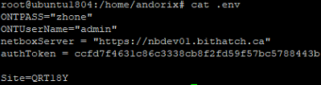
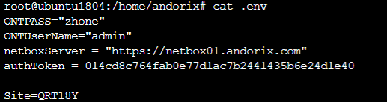
Auvik Scripts
Issue:
Many errors occurred in the Auvik terminal originally
Scripts were not running all the way through
Some sites were running to dev instead of prod NetBox
Action:
Added code to the scripts to catch and fix errors
Edited some sites to start scanning to the prod NetBox instead of the dev NetBox
Impact:
All sites now scan properly all the way through
If an error occurs, the rest of the code can still run and NetBox will still be populated

Slide 5


Cron Jobs
Issue:
Cron jobs were being created multiple times
NetBox was being overpopulated which caused errors and would stop the scripts from running
Action:
Changed cron job schedule to run once a day
Manually deleted all duplicate cron job entries
Edited and updated the install shell script
Impact:
Each site now only has one cron job running once per day
NetBox is able to handle the imports without causing errors
Auvik and NetBox are not being overpopulated, scripts can run smoothly

Slide 6

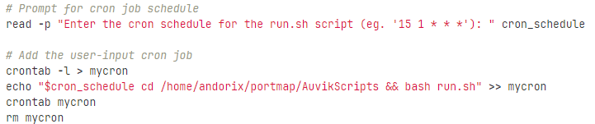
Install.sh
Issue:
Cron jobs were being added even if one already existed for a site
All sites had their cron job running at the same scheduled time, which is too much for NetBox to handle
Action:
Added a function to install.sh script to check if a cron job already exists for the specified site
Installation is skipped if the cron job already exists
Added another function that prompts the user to input a specific scheduled time for the cron job to run the run.sh script for a site
Impact:
No duplicated cron jobs in the Auvik terminal → no errors in NetBox
More flexibility with the input cron schedule, the user can customize the schedule for each site
Each site will have its own scheduled time, avoiding causing errors in NetBox and Auvik

Slide 7

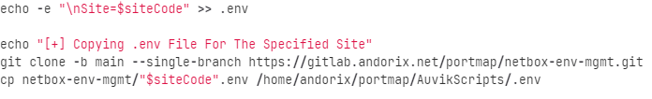
.env Files
Issue:
.env files for each site were being created locally in the Auvik terminal when the install script would run
If the file was not created properly, the other scripts would fail, causing NetBox to not be populated
Action:
Created a subproject in GitLab which contains individual .env files for each site
Some sites point to prod, some to dev NetBox
The install.sh script was edited to pull the .env file directly from GitLab for the specified site
Impact:
User inputs the site code when running the install.sh script
The corresponding .env file is pulled from the repository and added to the AuvikScripts directory in the terminal
Allows for easier editing of the .env files for individual sites

Slide 8

Modified Scripts
getONT.py
The main python file that telnets into the devices, parses data and generates CSVs
Edited the getONT.py script to associate MAC addresses on each ONT port to an IP in the automated workflow and update the CSV data
netbox_utils.py
Added a new script called “netbox_utils.py” that deals with NetBox configuration
It reads the updated CSV data, then iterates over the lines to import the data to NetBox
This allows the network to be scanned for ONT devices and establish telnet connections, MAC address to IP address mapping is performed for each VLAN, and data is updated, which is then imported to NetBox
ports-per-ont.py
Wrote “ports-per-ont.py” that would be added to the utils.py script and called in the getONT.py script
The goal is to output the number of active ports associated with each ONT using the portmapCSV that is already created during the initial scan
Final output would show the ONT IP address and the port count for each device

Slide 9


Phase 2 Development
Phase 1 included discovering ONT devices, adding refused connections to a troubleshooting list, developing portMap CSVs, and developing API to import information to NetBox
Phase 2 integrates the scripts written to associate MAC addresses on each ONT port to an IP address in the automated workflow
Final output would be a populated NetBox knowledge of which devices are connected to which ports on an ONT, as well as the MAC and IP addresses of the connected device

Slide 10
Phase 2 Code
A matching algorithm is used to leverage the MAC addresses as a comparison point to match the IP of the discovered device to its associated MAC address and ONT in NetBox
The result of the scans are collected which will provide the MAC and IP addresses of the discovered devices on each VLAN, using the MAC addresses as a comparison point
Aim is to enhance the system’s functionality by providing a solution that integrates with the existing infrastructure
Enriches the data available in the NetBox database

Slide 11
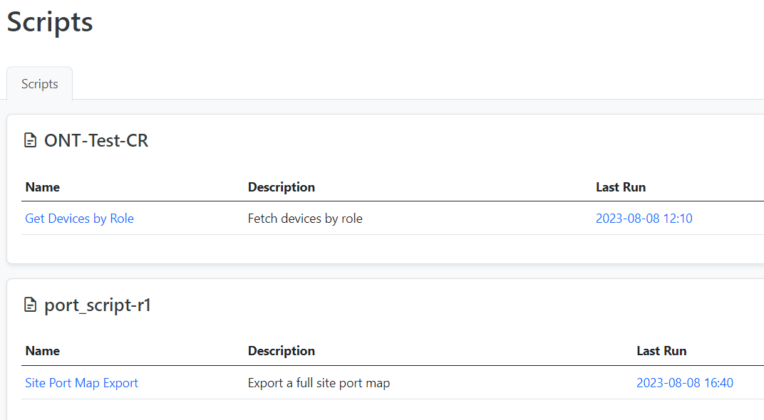
NetBox Reports
Wrote various scripts that would generate a report in NetBox
“ONT_Script.py” → generates an inventory report of all ONTs at a site
“port_script.py” → generates a full site-level report, including all systems and ports
“vlan_script.py” → generates a system-level report that would display the VLANs per system port map
These scripts have been uploaded to NetBox but not tested throughly, as some internal issues are preventing them from running all the way through

Slide 12
Thank you!
Questions?

